Slide 1
A Presentation on Question Answering in Natural Language Processing
Presented By:
Aashish Gyanwali (078MSIISE-1)
Bishal Maharjan (078MSIISE-3)
Nabin Upreti (078MSIISE-11)

Slide 2
Outline
Applications
Introduction to Factoid QA
Evaluation of factoid QA
Explanation of modules
Block Diagram
Question Processing
Goal of the Question Processing
Approaches to QA
Passage Retrieval
Algorithms for Passage Retrieval
Answer Processing
Answer Extraction
References
To be covered later:
Evaluation of Factoid Answers

Slide 3
Applications
Search engines like Google, Yahoo etc.
Chatbots in various websites
Systems used in call centers
Robots
Voice assistant like Alexa

Slide 4
Factoid Question Answering
Question Answering (QA) is a fast-growing research area that brings together research from Information Retrieval, Information Extraction and Natural Language Processing.
The Question Answering (QA) task has received a great deal of attention from the Computational Linguistics research community in the last few years (e.g., Text REtrieval Conference TREC 2001-2003)
The definition of the task, however, is generally restricted to answering factoid questions: questions for which a complete answer can be given in 50 bytes or less, which is roughly a few words.

Slide 5
Factoid Questions
For example, “When was X born?”, “In what year did Y take place?
The recent research trend is shifting toward more complex types of questions such as:
Definitional questions (biographical questions such as “Who is Hilary Clinton?
Entity definition questions such as “What is DNA?”)
List questions (e.g. “List the countries that have won the World Cup”)
Scenario-based QA (given a short description of a scenario, answer questions about relations between entities mentioned in the scenario) and why-type questions.

Slide 6
Factoid Questions
There exist clearly defined and relatively uncontroversial evaluation standards for factoid QA
In factoid QA, there is usually only one or at most a few correct answers to a given question, and the answer in most cases is a single word token or a short noun phrase.
The system returns one or more ranked answer candidates for each question, and they are judged manually for correctness

Slide 7
Factoid Questions
In TREC and CLEF, each answer candidate is assessed as (Magnini et al. 2006):
1. correct: if neither more nor less than the information required by the question is given. The answer needed to be supported by the docid of the document(s) in which the exact answer was found, and the document has to be relevant.
2. unsupported: if either the docid was missing or wrong, or the supporting snippet did not contain the exact answer.
3. inexact: if contained less or more information than that required by the question (e.g. if question asks for year but answer contains both year and month).
4. incorrect: if the answer does not provide the required information.

Slide 8

Factoid Questions
top1 and top5 accuracies and Mean Reciprocal Rank (MRR) scores are reported for correct and correct+unsupported answers.
TopN accuracy of correct answers is calculated as the number of questions in which at least one of the top N answer candidates is correct, divided by the total number of questions.
MRR is calculated as:
where N is the number of questions and rank(Qi) is the rank of the topmost correct answer of question i

Slide 9
Factoid Questions
A typical QA system usually employs a pipeline architecture that chains together three main modules:
Question analysis module: This module processes the question, analyzes the question type, and produces a set of keywords for retrieval.
Depending on the retrieval and answer extraction strategies, some question analysis module also perform syntactic and semantic analysis of the questions, such as dependency parsing and semantic role labeling.

Slide 10
Factoid Questions
Document or passage retrieval module:
This module takes the keywords produced by the question analysis module, and uses some search engine to perform document or passage retrieval.
Two of the most popular search engine used by many QA systems are Indri (Metzler and Croft 2004) and Lucene.

Slide 11
Factoid Questions
Answer extraction module
Given the top N relevant documents or passages from the retrieval module, the answer extraction module performs detailed analysis and pin-points the answer to the question.
Usually answer extraction module produces a list of answer candidates and ranks them according to some scoring functions.

Slide 12
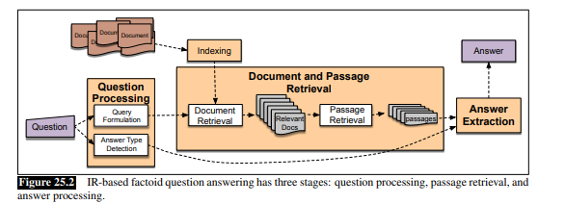

Slide 13
Question Processing
Same question may be asked in different forms.
We may ask it in interrogative way or the assertive way.
We need to understand the semantics of the question.
We need to recognize what the question is asking for before proceeding to answer the question itself.
The practice to understand the question is termed as Question Processing

Slide 14
Question Processing
Example: We are seeking same information using different forms of the question:
Interrogative
- Question: What is the capital city of India?
Assertive
- Question: Tell me the name of city which is capital of India?

Slide 15
Question Processing
The main goal of the question-processing phase is to extract the query:
the keywords passed to the IR system to match potential documents.
Some systems additionally extract further information such as:
Answer type: the entity type (person, location, time, etc.) of the answer.
Focus: the string of words in the question that is likely to be replaced by the answer in any answer string found.
Question type: Is this a definition question, a math question, a list question?

Slide 16
Question Processing
For example: for the question Which US state capital has the largest population? the query processing might produce:
Query: “US state capital has the largest population”
Answer type: city
Focus: state capital

Slide 17
Question Processing
The Question Processing results are a list of keywords plus the information for asking point. For example, the question:
Who won the 1998 Nobel Peace Prize?
contains the following keywords: won, 1998, Nobel, Peace, Prize.
The asking point Who refers to the NE type person.
The output before question expansion is a simple 2-feature template as shown below:
-asking_point: PERSON
- key_word: { won, 1998, Nobel, Peace, Prize }

Slide 18
Question Processing
The question processor scans the question to search for question words (wh-words) and maps them into corresponding NE types/sub-types or pre-defined notions like REASON.
We adopt two sets of pattern matching rules for this purpose:
(i) Structure based pattern matching rules;
(ii) Simple key word based pattern matching rules (regarded as default rules).

Slide 19
Approaches to Question Answering
Information Retrieval based QA
Open domain QA
Depends on huge source of text e.g., collection of papers, web, etc.
Relevant piece of information is returned by the system
Knowledge Based QA
Query is represented in a semantic form
Example: “What are neighbor countries of Nepal?” is represented as “λx.country(x) ∧ neighbor(x, Nepal)
Such representation will be used to query databases of knowledge

Slide 20
Passage Retrieval Introduction
Retrieving only those passages i.e., parts of a document that are relevant to needed information
Helps searcher to pinpoint the relevant information in a document
Intermediate step in question answering systems
Collection of
Documents
Inverted
Index
Indexing
Ranked Documents
…
….
….
Searching
Query
Processing
Query
Vector
Query

Slide 21
Passage Retrieval Algorithms
Classical or Sparse Retrieval Algorithms
TF-IDF
BM25
Neural or Dense Retrieval Algorithms
BERT
Dense Passage Retriever (DPR)

Slide 22
Classical or Sparse Retrieval Algorithms
Using TF-IDF or BM25
Key idea: Chance of a piece of text to be about a word increases with the frequency of the word in that text
More frequent number of words from a question in a passage means the passage is relevant
Advantage:
Simple and fast
Disadvantage:
Omits importance of word order
Does not adhere to meaning of words and grammatical structure

Slide 23

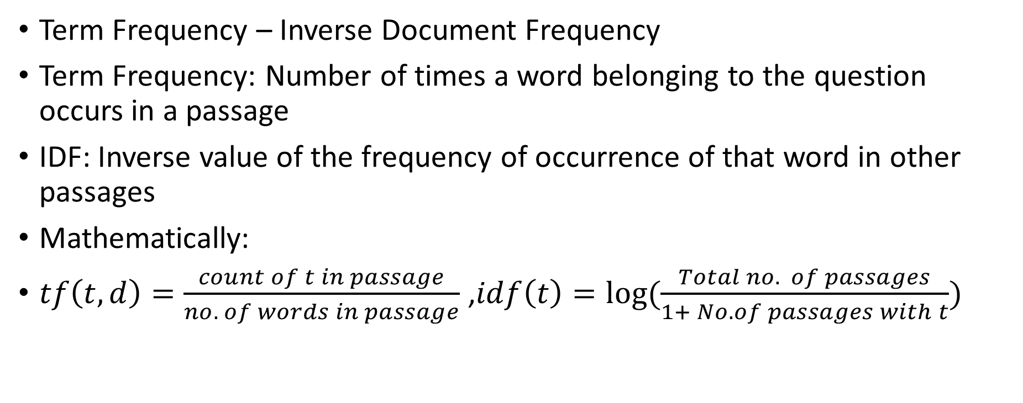
Retrieval Using TF-IDF Mathematics
Term Frequency – Inverse Document Frequency
Term Frequency: Number of times a word belonging to the question occurs in a passage
IDF: Inverse value of the frequency of occurrence of that word in other passages
Mathematically:
$tf\left(t,d\right)=\frac{count of t in passage}{no. of words in passage}$ ,$idf\left(t\right)=log(\frac{Total no. of passages}{1+ No. of passages with t})$
$$tf_idf\left(t\right)=tf ×idf$$

Slide 24
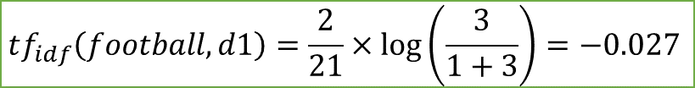
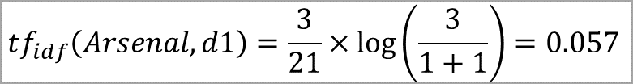
Retrieval Using TF-IDF Illustration
Document 1:
Arsenal Football Club is a football club based in London, United Kingdom.
Arsenal is performing better this season.
Arsenal will probably be in good ranks at the end of the season.
Document 2:
Machhindra Football Club is a football club based in Kathmandu, Nepal.
Machhindra won Martyr's Memorial A-division league in 2078 BS.
They are good contenders for this season too.
Document 3:
Football Club Barcelona is a football club based in Barcelona, Spain. Barcelona is performing well in Spanish league under Xavi Hernandez this season.
$$tf_{idf}\left(Arsenal, d1\right)=\frac{3}{21}×\log\left(\frac{3}{1+1}\right)=0.057$$
$$tf_{idf}\left(football, d1\right)=\frac{2}{21}×\log\left(\frac{3}{1+3}\right)=−0.027$$

Slide 25
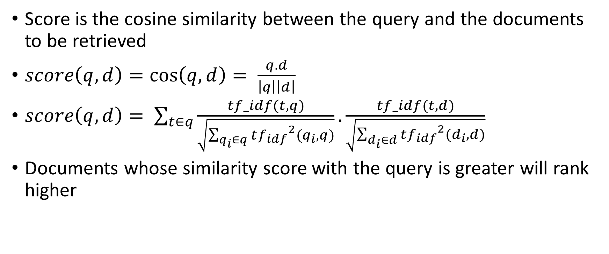
Retrieval Using TF-IDF Document Scoring
Score is the cosine similarity between the query and the documents to be retrieved
$score\left(q,d\right)=\cos\left(q,d\right)= \frac{q.d}{\left|q\right|\left|d\right|}$
$score\left(q,d\right)= \sum_{t∈q}{\frac{tf_idf(t,q)}{\sqrt{\sum_{q_{i}∈q}{{tf_{idf}}^{2}(q_{i},q)}}}.\frac{tf_idf(t,d)}{\sqrt{\sum_{d_{i}∈d}{{tf_{idf}}^{2}(d_{i},d)}}}}$
Documents whose similarity score with the query is greater will rank higher

Slide 26
Retrieval Using TF-IDF Suggested Improvements
Improvements suggested by Danqi Chen, et.al (2017)
Taking local word order into account
Use of n-gram features
The paper made use of bi-grams
Improvements suggested by Philemon Kasyoka, et. al.(2014)
Use of Term Proximity approach
2 types of approach
Span-based approach: Span is length of a document fragment that covers all query terms
Pair-based approach: Distance between individual query terms

Slide 27
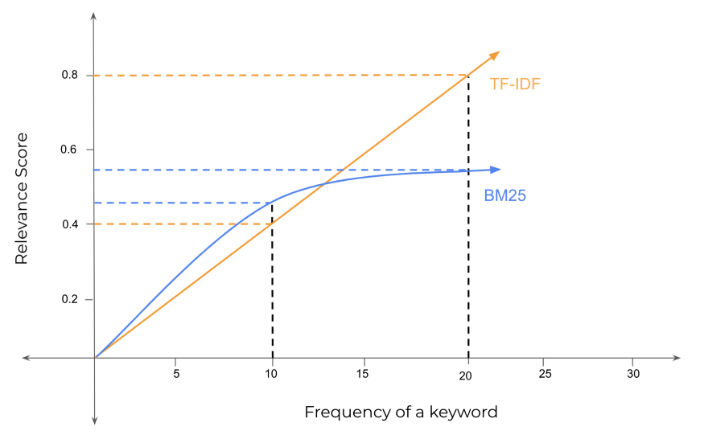
Retrieval Using BM25 Need of BM25
Best Matching (BM)
Optimized and complex version of TF-IDF
Compensates the defect of TF-IDF that gives more advantage to longer passage over shorter passage
BM25 modifies TF formula so that:
TF saturates after certain no. of
occurrence of a term in a passage
Passages with different lengths are
normalized giving shorter passages
more advantage over same frequency
of words from question

Slide 28
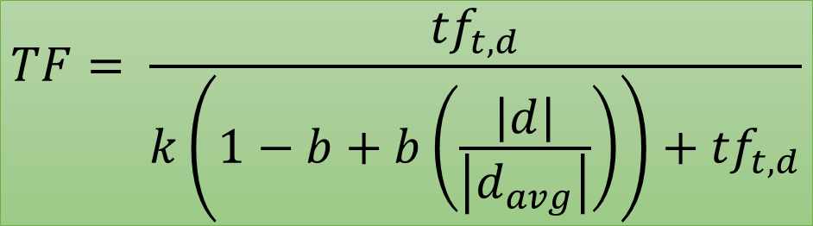
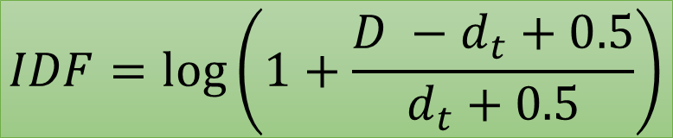
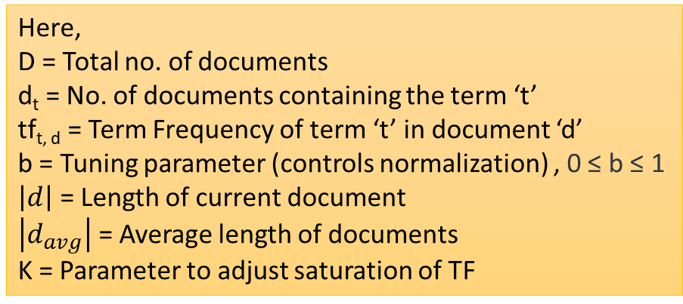
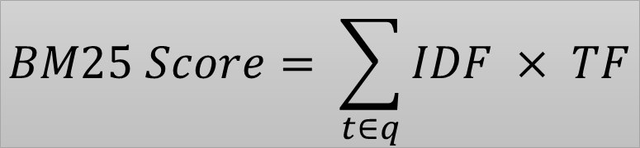
Retrieval Using BM25 Mathematics
$$TF= \frac{{tf}_{t,d}}{k\left(1−b+b\left(\frac{\left|d\right|}{\left|d_{avg}\right|}\right)\right)+{tf}_{t,d}}$$
$$IDF=\log\left(1+\frac{D −d_{t}+0.5}{d_{t}+0.5}\right)$$
$$BM25 Score= \sum_{t∈q}{IDF × TF}$$
Here,
D = Total no. of documents
d_{t} = No. of documents containing the term ‘t’
tf_{t, d} = Term Frequency of term ‘t’ in document ‘d’
b = Tuning parameter (controls normalization) , 0 ≤ b ≤ 1
$\left|d\right|$ = Length of current document
$\left|d_{avg}\right|$ = Average length of documents
K = Parameter to adjust saturation of TF

Slide 29
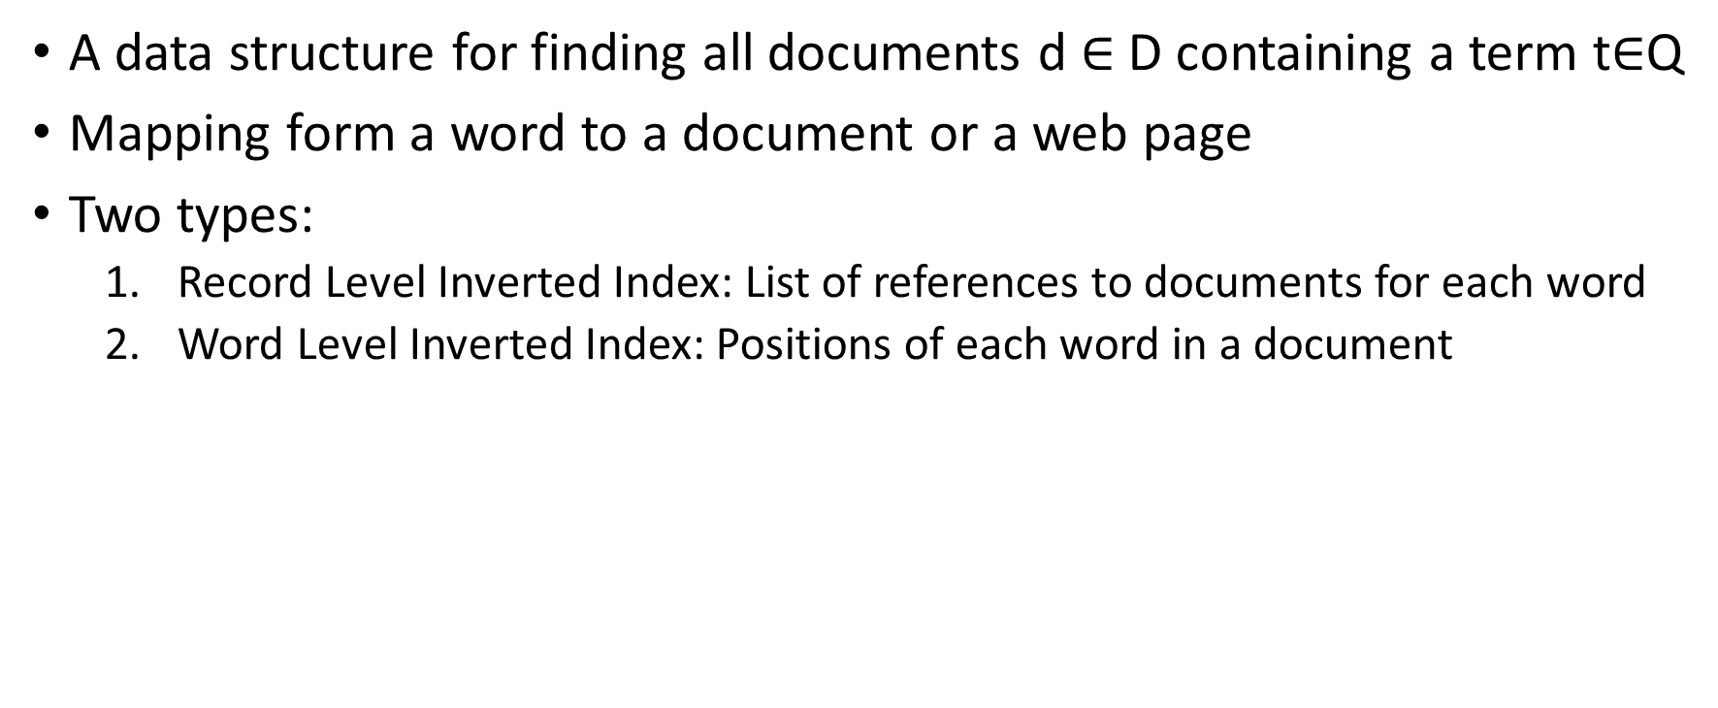
Inverted Index Basic Idea
A data structure for finding all documents d $∈$ D containing a term t$∈$Q
Mapping form a word to a document or a web page
Two types:
Record Level Inverted Index: List of references to documents for each word
Word Level Inverted Index: Positions of each word in a document
Words | Document
Nepal | 2
Ocean | 1,2
world | 1,2
Messi | 3
Table: Inverted Index

Slide 30
Neural or Dense Retrieval Systems
Computation of relevance score using dense representations
Queries and passages encoded to low-dimensional dense vectors rather than high-dimensional sparse vectors in sparce retrieval
Advantages:
Captures semantic similarity i.e., clever, intelligent, talented, etc. are similar words
Differentiates ambiguous words i.e., bank of Bagmati and Bank of Kathmandu
Disadvantages:
Slower than spare retrievers

Slide 31
Dense Retrieval with Neural Encoders
Collection of
Documents
Passage
Encoder
Ranked Documents
…
….
….
Passage
Representations
Query /Information
Needed
Query
Encoder
Query
Representation
Retriever
Fig: Dense retriever with neural encoders

Slide 32
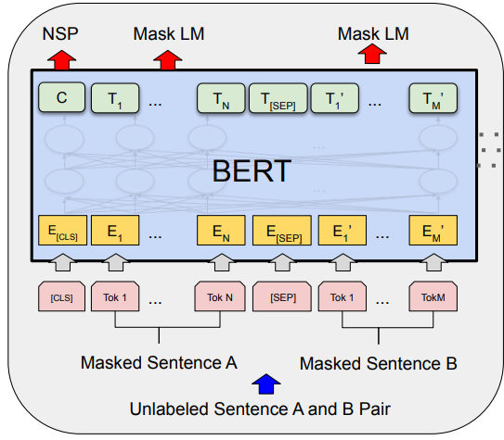
BERT Basic Idea [1]
Bidirectional Encoder Representations from Transformers
A language model for learning the context and representing in form of vector encodings
Two steps of solving problems using BERT
Pretrain BERT: To understand language
Fine tune BERT: To learn perform a specific task
Pretrain BERT (unlabeled data)
Masked Language Modeling
Masked (hidden) tokens are guessed by model in
training
Next Sentence Prediction
Understanding context between tokens
Fig: Pretraining BERT

Slide 33
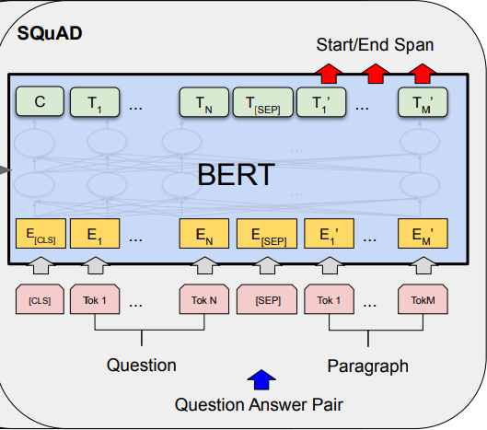
BERT Basic Idea [2]
Fine Tune BERT for Question Answering (labeled data)
Input: Question and a passage containing the answer is provided to the model
Output: Start and End words that encapsulate the answer assuming answer lies in the passage
Dataset needed for training like,
SQuAD : Stanford Question Answer Dataset
Natural Questions (NQ)
TriviaQA: Web Scraping
Fig: Fine Tuning BERT using SQuAD

Slide 34
Sentence BERT
For comparing semantic similarities of whole sentences
Generates relevance scores by calculating cosine similarity between question vector and vectors of all passages
BERT encoder used to generate the vectors (question vector and passage vectors)
Passage (vector) with more cosine similarity value with the question (vector) will be considered more relevant
Passage A
Question
α
θ
Passage B

Slide 35
Dense Passage Retriever (DPR)
Similar to SBERT but uses two different BERT encoder models, one for Question vector and other for passages
Dense encoder E_{P}(.) maps text passage to d-dimensional real valued vector during inference time
Index will be built for all M passages that will be used for retrieval
Different encoder E_{Q}(.) maps input question to d-dimensional vector
‘k’ passages closest to question vector will be retrieved and ranked based on similarity
$$similarity\left(q,p\right)=E_{Q}{\left(q\right)}^{T}E_{P}(p)$$

Slide 36
Answer Processing Reader
After retrieving relevant passage, the QA model should present the required answer.
Reader performs the task of extracting the exact answer
Start
End
Which countries border Nepal?
Question
Reader
India and China
Answer
Nepal lies in between
India and China.
Relevant Passage

Slide 37
Answer Extraction Span Labeling [1]
Identifying span in the passage that contains an answer to the query
Readers are provided with:
Passage p of m tokens, p₁, p₂, …, p_{m}
Question q of n tokens, q₁, q₂, …, q_{n}
Job is to find probability P(a|q,p) such that span ‘a’ is the answer
For each token p_{i}, p_{start}(i) and p_{end}(i) is calculated that indicate probabilities for p_{i} to be start or end of span

Slide 38


Answer Extraction Span Labeling [2]
Any encoder model like BERT can perform the task
Dot product of learnt embedding (S or E) and the token embedding p_{i} is provided to softmax layer
Loss function for training is given by log-likelihoods as:
$$p_{start}\left(i\right)= \frac{e^{S.p_{i}}}{\sum_{j}{e^{S.p_{j}}}}$$
$$p_{end}\left(i\right)= \frac{e^{E.p_{i}}}{\sum_{j}{e^{E.p_{j}}}}$$
Here, start embedding S and end
embedding E are learnt in fine tuning
of BERT
$$L=−\log\left(p_{start}\left(i\right)\right)−log⁡(p_{end}\left(i\right))$$

Slide 39
Answer Processing Encompassing Token Features
Manual features can be added which reflect some properties of token p_{i} providing the context
Part of Speech
When answer’s POS is known
Example: Answer token of ‘What is capital city of Nepal?’ is a Proper noun
Named Entity Recognition
When NER of the answer is known
Example: NER of answer to “When will the election take place?” is a date.

Slide 40
References
V. Karpukhin, et. al., ‘Dense Passage Retrieval for Open-Domain Question Answering’, September 2020
D. Chen, et al., ‘Reading Wikipedia to Answer Open-Domain Questions’, April 2017
J. Devlin, et al., ‘BERT: Pre-training of Deep Bidirectional Transformers for Language Understanding’, May 2019
N. Reimers and I. Gurevych, ‘Sentence-BERT: Sentence Embeddings using Siamese BERT-Networks’, August 2019
P. Kasyoka, et al., ‘A Framework for Aggregating and Retrieving Relevant Information Using TF-IDF and Term Proximity in Support of Maize Production’, International Journal of Scientific and Technology Research, Vol.3, Issue 3, March 2014

Slide 41
References
D. Jurafsky and J.H. Martin, ‘Speech and Language Processing’, Chapter 23 ‘Question Answering’, December 2021
M. Wang, ‘A Survey of Answer Extraction Techniques in Factoid Question Answering’, Association for Computational Linguistics, 2006
C. Wade and J. Allan, ‘Passage Retrieval and Evaluation’, CIIR Technical Report, February 2005

